Slide 1
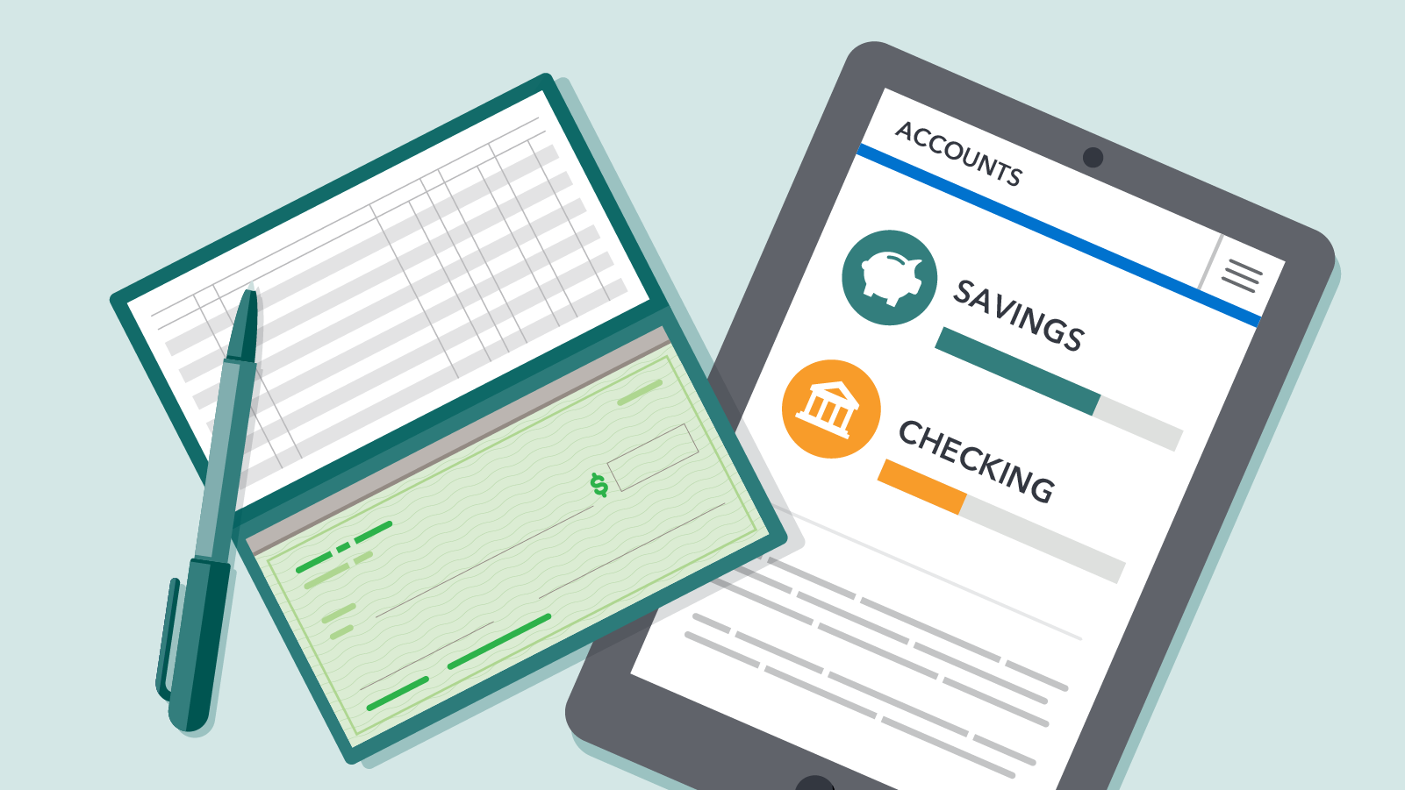
Distributed Account Verification System (DAVS)
Ravi Sreedharan
1

Slide 2
Project Synopsis
The DAVS provides a global, real-time Bank Account Verification service, leveraging Blockchain technology to remediate issues that exist in offering such as service via a centralized server.

Slide 3
DAVS Project Detail
The demand for a Bank Account Verification service is fairly common in the Banking/Payments world
Essentially, it's a request from a Payor to check whether the Payee bank account is valid; the Payee bank would confirm whether the bank account is:
(a) Open/Closed or
(b) has Incorrect Account Number or
(c) has Incorrect Account/Bene Name, etc.
Current experience for clients globally is very fragmented. In some countries, this is a regulatory requirement for banks to provide this service, however in most other countries no such service exists though the benefits are significant (fraud prevention, improve STP/less chances of delayed payments, etc) and the demand for such a service exists.
Deploying this solution on a blockchain takes away the current geographical and technology complexities that limit the availability of a standardized, global service.
The idea is to connect all stakeholders engaged in the Money movement/Payments world (i.e., banks, non-bank fintechs, Credit Unions, Money Transfer services, Digital Banks, Corporates, etc) in a global, decentralized, private and permissioned blockchain.
Participants can query the blockchain (the data in each block will have a dictionary that stores details such as the Bank Name, Branch Name, Account Number, Account Name and Account Status) and receive a response.

Slide 4
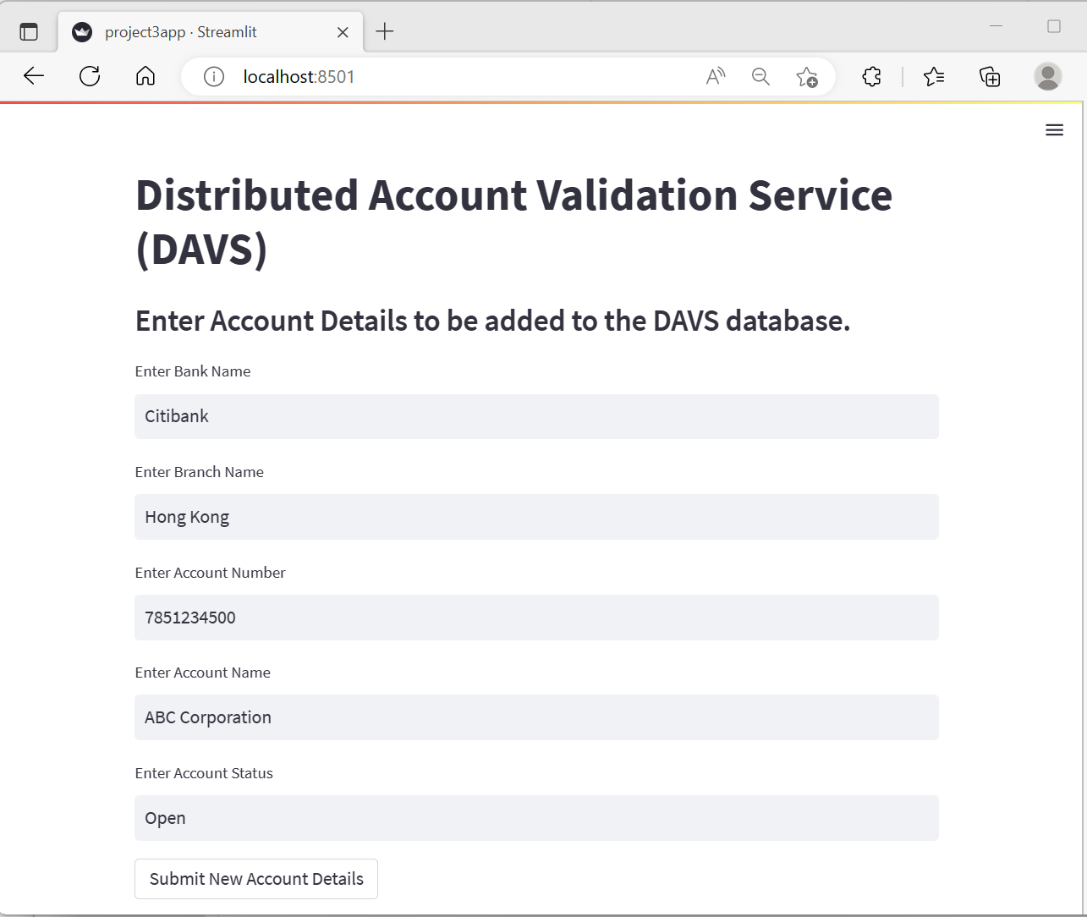
Screenshot #1: Submit Account Details
This the user interface for participants/providers (essentially Banks) to provide Account Information to DAVS, which then will add it to the blockchain for further query by other participants.
In the real-world, this functionality may be made available via API calls and/or File Uploads, in addition to an online interface such as this one.

Slide 5
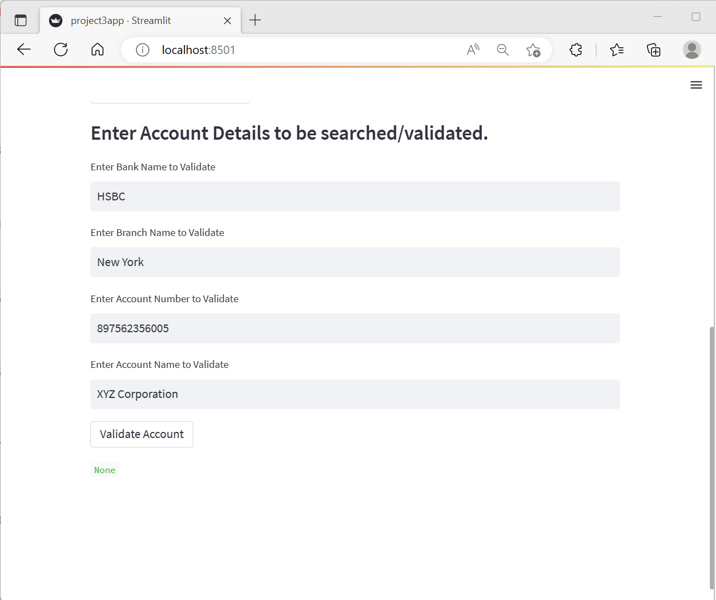
Screenshot #2: Query Account Details
This the user interface for ALL participants to query/validate Bank Account Information on DAVS.
Upon pressing the Validate Account, the DAVS will loop through the Blockchain and return the Account Status in case of a match (‘None’ in case of no match).

Slide 6
Future Build Opportunities
Add value-added add-on services
Additional Input/Output options
The service can be developed further to respond with correct values (e.g., in case of incorrect or incomplete account numbers or names in query requests)
Allow participants to interact with the DAVS via channels such as Open Banking/API and file-based channels.
Expanded functionality
Monetize the service
Provide activity status (e.g., whether there was any transaction activity in the account in past 30/60/90 days).
Queries can be billed at a per-query and/or data level, and Information providers (i.e. the Account-holding Banks) can be compensated from that income.

Slide 7

Thank You
Questions?

